Slide 1


Title I Annual Parent Meeting
PLUMB ELEMENTARY SCHOOL
AUGUST 8, 2023
4;00pm
PLUMB ELEMENTARY SCHOOL CLASSROOMS via NEWSROOM PROJECTION
HOLLY DEL DUCA: PRINCIPAL
Notes:
Evidence: Upload completed presentation and recorded feedback as part of the evidence to support the Annual Meeting Materials. Do not forget the sign-in sheets, and survey/feedback that you receive throughout the meeting.

Slide 2

All About Title I
Title I is the largest federal assistance program for our nation’s schools.
The program serves 85 schools in Pinellas County including eligible students in 36 non-public schools.
Notes:
Highlight the Title I Program here in Pinellas County.

Slide 3

Title I Funding Process
2. Florida Department of Education
1. Federal Government
3. Pinellas County Schools
4. Plumb Elementary
Notes:
The Florida Department of Education receives funds from the federal government. Districts receive Title I funds from Department of Education, and the school district distributes these funds to schools based on the percentage of children eligible for free/reduced price lunch; however, students do not have to be from low-income families to receive help.

Slide 4

Title I
Supplemental Resources
Definition: provided in addition to what is already present or available to complete or enhance it.
https://languages.oup.com/
Notes:
Title I is supplemental federal funding that provides in addition to what is already present or available to complete or enhance extra academic support and learning opportunities for economically disadvantaged students.

Slide 5


Let’s Celebrate!
Plumb Scholars demonstrated strong proficiency rates across ELA, Math and Science during the 2022-2023 school year.
Grades 3-5 Proficiency Rates
  Reading Proficiency: 60%
  Math Proficiency: 73%
  Science Proficiency: 70%
  Our school demonstrated growth in all 3 content areas
Notes:
Based on the FSA data and school grades, there is a lot to celebrate!!
How did your Title I Resources support or enhance the work that you were able to get done?

Slide 6

Title I Schoolwide Budget
Plumb Elementary is provided funding to pay for supplemental resources and programs for increased student achievement.
  Title 1 Hourly Teachers
  Resources for Teaching Foundational Reading Skills
  Professional Development and Collaborative Planning for Teachers
  Curriculum Supplies
  Family Engagement Nights
  Technology Resources and Programs

Slide 7

Parent’s Right to Know
As a parent of a student attending a Pinellas County School Public School, you have the right to…
Be provided information on your child’s level of achievement on assessments in Reading/Language Arts, Writing, Mathematics, and Science.
Request and receive information on the qualifications of your child’s teacher and supplemental personnel working with your child.
Be
Be notified of non-highly qualified or out-of-field teachers at the school.
Be

Slide 8
Working Together for Student Success
School
School Improvement Plan (SIP)
Title
Title I Schoolwide Plan
Parent
Parent and Family Engagement Plan
School
School-Parent-Student Compact
Notes:
As a Title I parent you have the right to be involved in the development of the following plans and documents for our school which can be found on our website to view as well as in the Parent Station located in the front office.
You will find a copy of our School Improvement Plan, Title I Schoolwide Plan, School’s PFEP, the School District’s PFEP, Parent’s Right to Know Memo, Upcoming Events, Compact. At this time the Resource Station and website are in progress of gathering all of these resources as these resources are in their final stages of completion.
School Improvement Plan (SIP)
Parent and Family Engagement Plan
Title I Schoolwide Plan
School-Parent-Student Compact

Slide 9
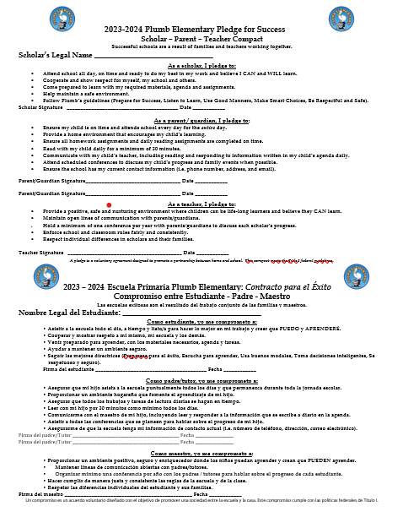

Plumb Elementary School Compact
Notes:
Please see the Parent- Student- Staff Compact on your child’s desk.

Slide 10

Parent-School-Student Compact
The purpose of the compact is to foster student achievement. By signing the Parent-School-Student Compact, Plumb Elementary teachers, staff, parents and students agree to work together to share the responsibility of helping students meet or exceed state, district and school academic goals.
The Parent-School-Student Compact will be updated every year to include parent, student, teacher, and staff input. Parent, student, teacher and staff comments are welcome at any time during the year.
Please review and sign your child’s Compact.
Our goal is to receive 100% signed compacts!
Notes:
At the elementary level, school compacts are used as a progress monitoring tool through the year during parent teacher conferences.
Please leave the compact on your scholar’s desk. Your teacher will send home a copy to you in the next few days.

Slide 11

Parent and Family Engagement Plan (PFEP)
The PFEP Sections include information about the following:
  Parent trainings to increase student achievement
  Communication methods between home and school
  Flexible meeting times
  Resources to support families
Notes:
Provide information on the specific committees that parents can be involved. Include the purpose, date and time of meetings.
Explain the PFEP and its purpose.
Consider the evidence related Title I Crate, Sample of Evidence,

Slide 12

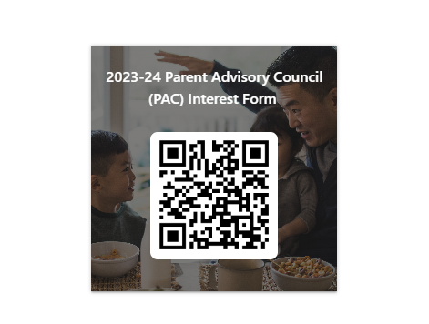
Parent Advisory Council (PAC)
The District has a Parent and Family Engagement Plan. The summary of the plan is in the Title I School & Family Partnership Overview.
You may access the full plan at www.pcsb.org/titleone
The Parent Advisory Council (PAC) is responsible for reviewing and revising the District PFEP.
PAC will meet virtually or in-person with the district’s Title I staff.
PAC meets twice a year, if you are interested in representing our school please notify, Mrs. Del Duca at delducah@pcsb.org
Notes:
Please add your PAC representative in slide and share with your Title I Specialist.
https://forms.office.com/r/r5daaMTENE\

Slide 13
Contact Us
1920 Lakeview Road
Clearwater, Florida
33764
Phone: 727-469-5976
Email
delducah@pcsb.org
stachc@pcsb.org
Notes:
Please insert the school contact information and the best way to reach out to the school.

Slide 14
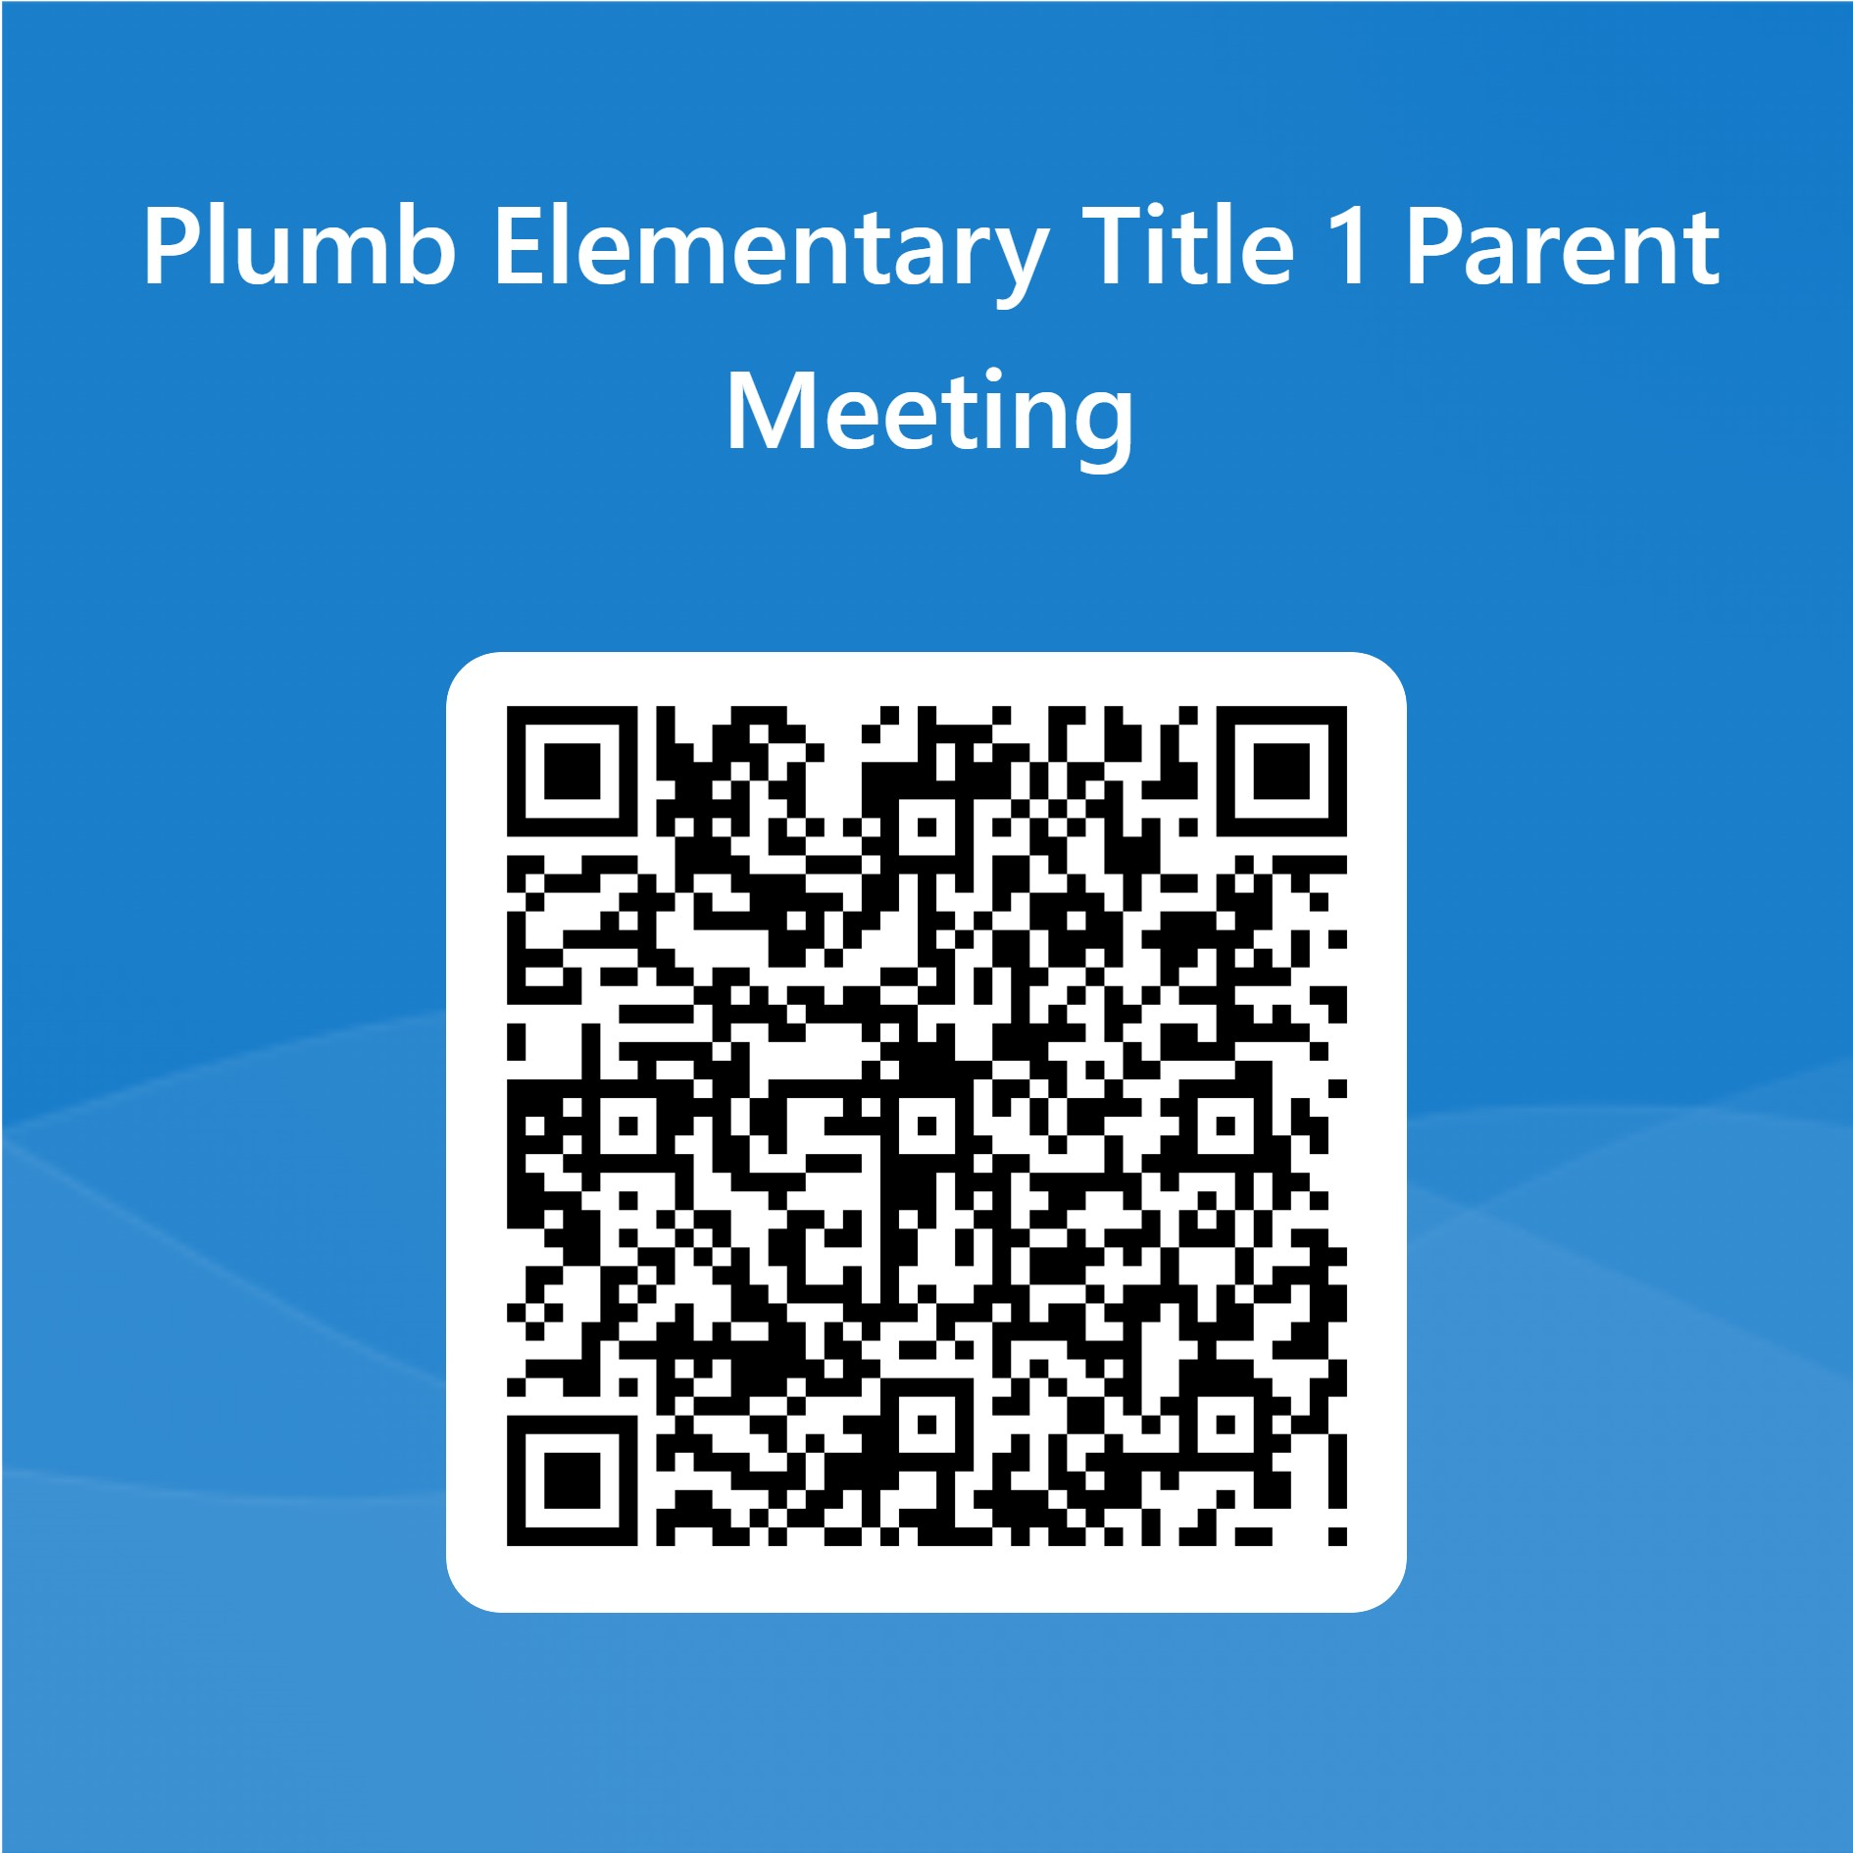

Thank you for your time!
Notes:
Thank you for your time. Please use the QR code to provide feedback regarding our Title 1 Annual Meeting.

Slide 17


Slide 18
Tips and Recommendations before you get started
Family Experience: Consider how to make the event FUN and INFORMATIVE for your families. Consider using Scavenger Hunt, Passport, and other ways to engage families while learning about the wonderful world of Title I!
Cross-Coordination: This continues to be an area of focus. Please consider how you can use other federal funds (Title III, IDEA, Business/Community) to maximize your event.
Family Engagement supporting document: Please consider using the Family Engagement documents for the Planning and Post-Event Summary for your reference.
Presentation Key:
- Optional - Required

Slide 19

Data Sources/Consider
Comprehensive Needs Assessment
School Improvement Plan
District Climate Survey (Title I Items)
PM3 Data/Connection to Phase III
Notes:
Calling out some data sources to get them started…

Slide 20

Accountability
  School Report Cards
  School Grade and Overview
  Population and Enrollment
  Assessments – Academic Achievement, Growth, and Population
  Assessments – English Language Learners
  Graduation and Beyond
  Educator Qualifications and Equity
  Long-Term Goals and Interim Progress
  Accelerated Course Enrollment
  Per-Pupil Expenditures
  National Data
  Available online at https://edudata.fldoe.org/ or Front Office

Slide 21
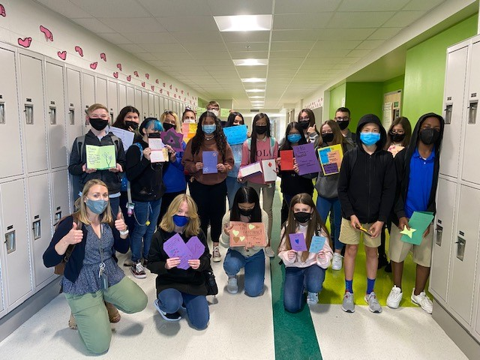

Additional Resources
Learning at Home Family Resources - https://www.pcsb.org/Page/32836
Volunteer in a Pinellas County School - https://www.pcsb.org/Page/459
Parent Academy POWER HOURS Webinars - https://www.pcsb.org/Page/26534
Partnerships - https://www.pcsb.org/Page/418

Slide 22

Family Lunch Days- information to come
Student Led Conference Dates
Academic Engagement Events for all content areas and the arts/PE
Notes:
Do you have a calendar of key events that are included in your PFEP.
Evidence – Consider this as evidence to include to support Family Engagement.

